Slide 2
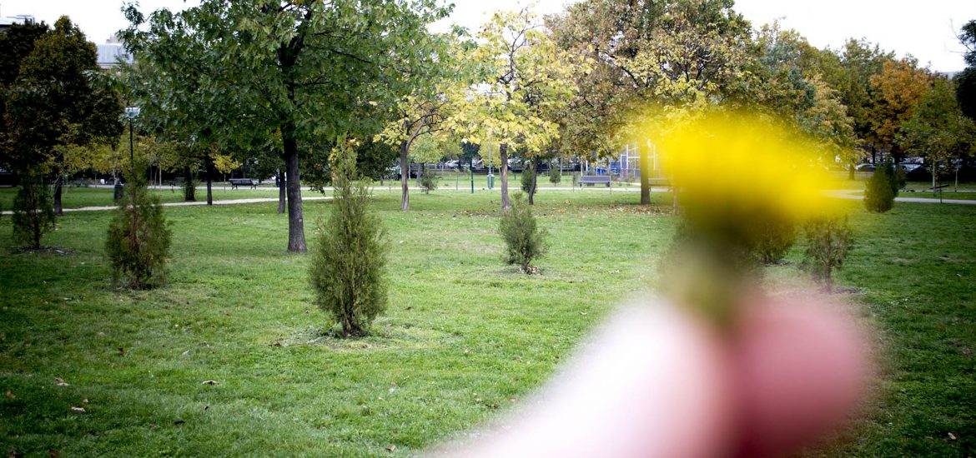
IMPROVING THE QUALITY OF LIFE

Slide 3
People start working and have responsibilities from very young ages.
Most people know they have unhealthy habits but they are willing to give them up only when they get to the hospital.

Slide 4
SEDENTARISM leads to: fatness, aging, stress, frequent headache, increased risk of diabetes, heart disease, sleep disorders, increased risk of cancer, constipation.

Slide 5
We are trying to help people get out of their comfort zone, motivate them to work for their future, eat healthy, socialize with different people, to encourage them to do sports.

Slide 6
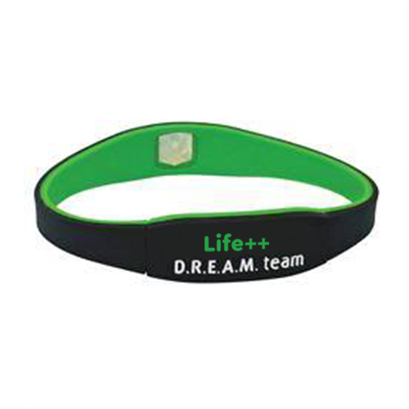
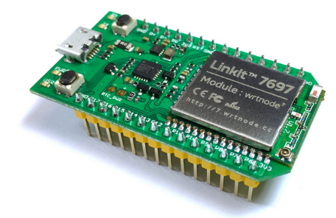
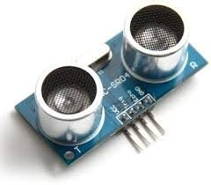
What is special about this project?
It costs only 20$.
A nice look, a normal bracelet size.
+

Slide 7
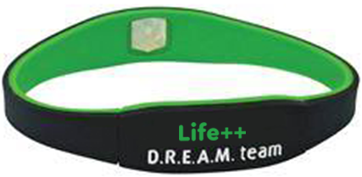
How do we get to the customer?
Reliable services
Cheap product
Nice look

Slide 8
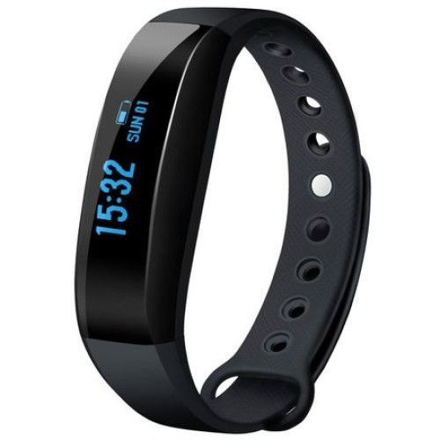
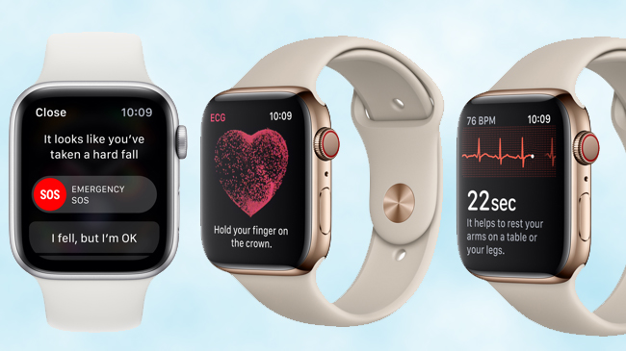
COMPETITION
More expensive, it does not offer the same services.

Slide 9
Financial forecast and key indicators
A high reach level to the younger generation
Over 10,000 customers in the first year
Reach out to at least 5 cities in the first year
Excellent reviews from our customers
Establishing relationships

Slide 10
Future developments
Implementing an AI system to automatically generate custom notifications and advices for the web application
Integrate more gadgets
Incorporating a dehydration sensor into the bracelet
Bind our application with a virtual personal assistant – e.g. Google assistant

Slide 11
