Slide 1
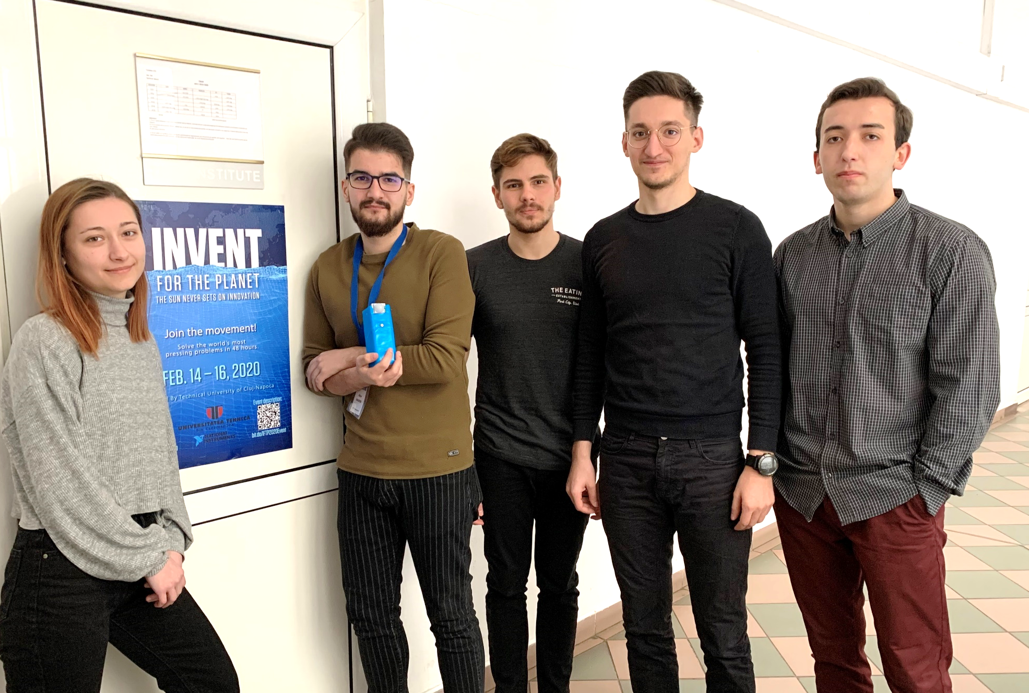
THE TEAM
Nemes Alice
Marin Alex-Stefan
Crisan Darius Ciprian
Cioata Sebastian
Ont Rares

Slide 2
WHAT
?

Slide 3
PREVENTING INJURIES TO DISTRACTED PEDESTRIANS

Slide 4
3.
Pedestrian and driver distraction
2.
Unsafe infrastructure
1. Unpredictable situations

Slide 5
WHY
?

Slide 6
50%
1.35
of all road traffic deaths
million people die
every year as a result of road traffic crashes
are among vulnerable road users: pedestrians, cyclists, and motorcyclists.
Between 20 & 50 million people
suffer non-fatality injuries.
*according to World Health Organization

Slide 7
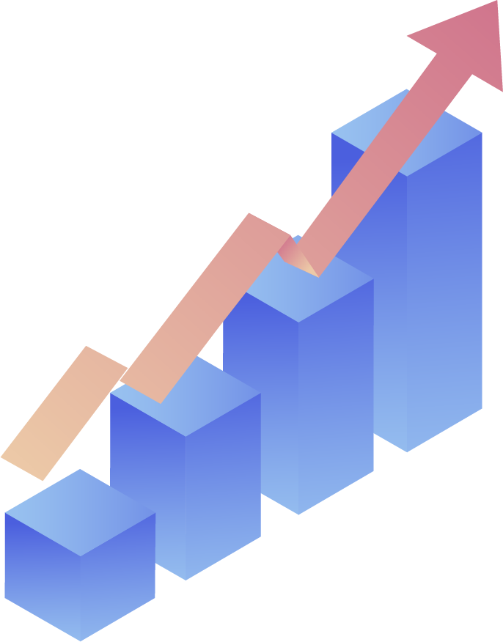
11%
50%
of accidents
were determined as shared or unknown fault
of pedestrians
were at fault
39%
of drivers
were at fault for accidents
Non-intersections
are rated the highest in a city where pedestrians are hit
*according to data from cities, Baltimore and Washington, District of Columbia

Slide 8
OUR SOLUTION

Slide 10
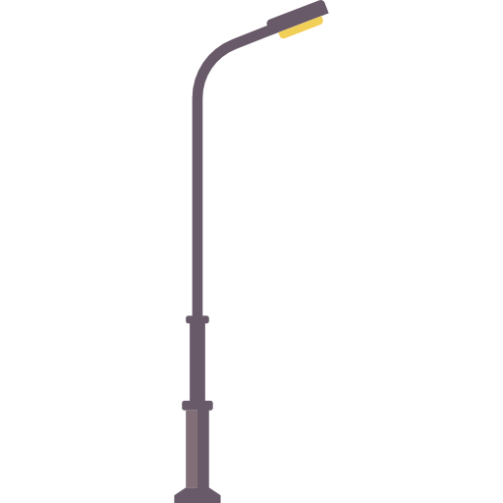

Slide 11
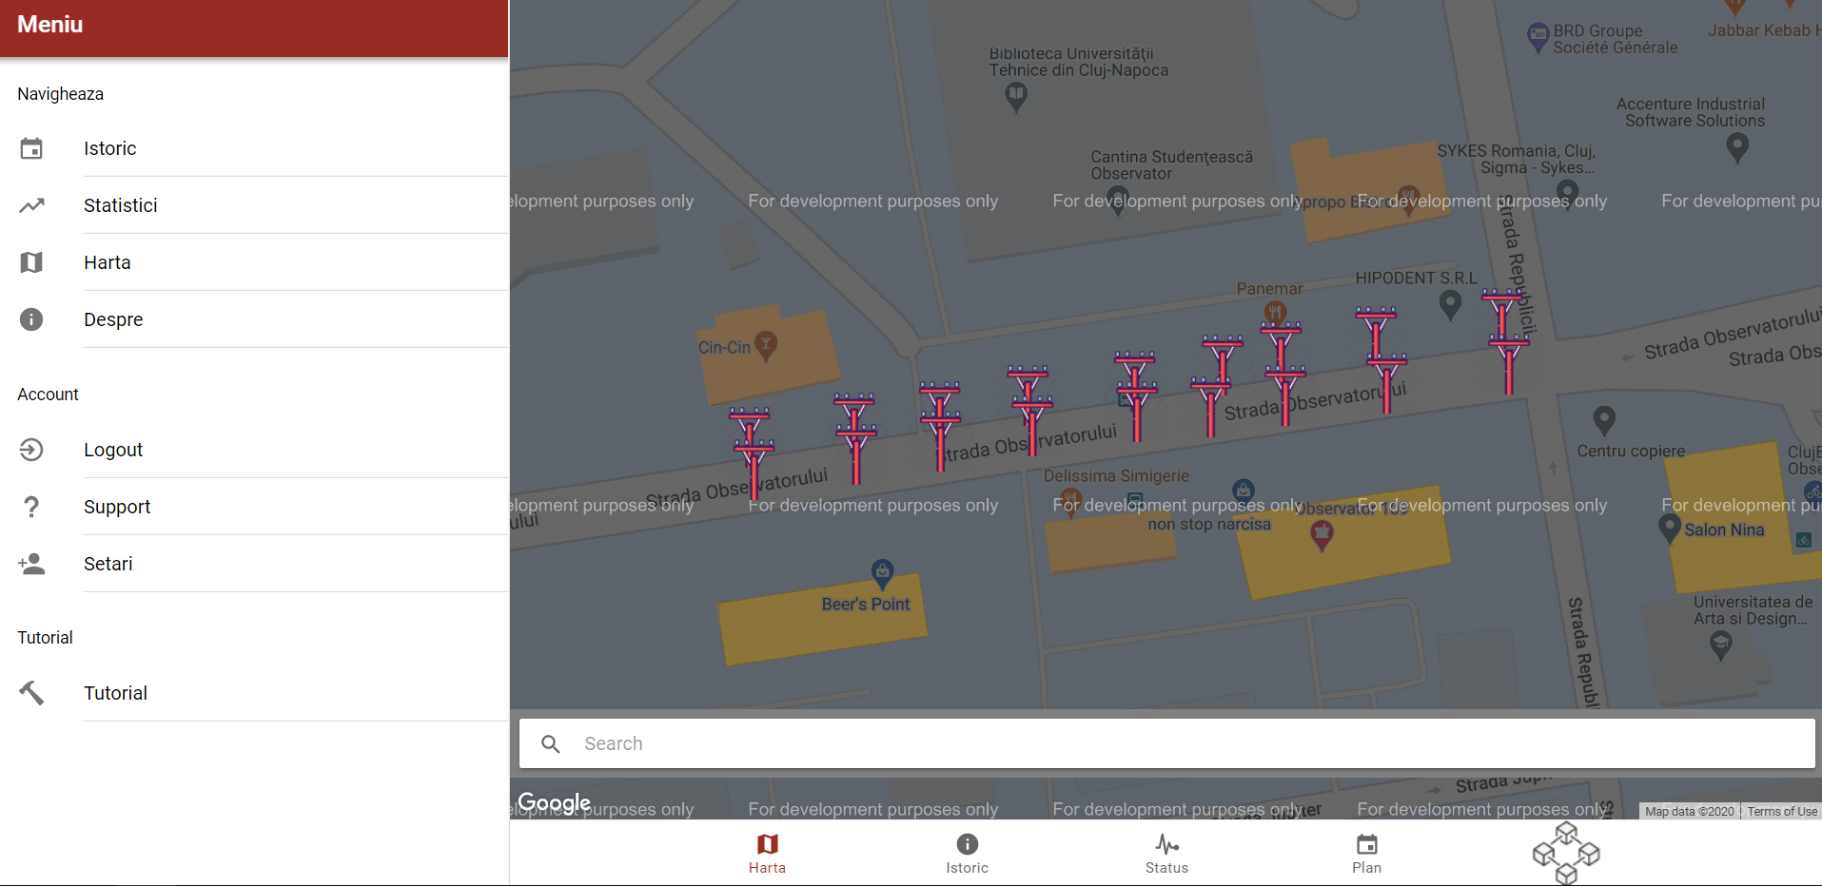

Slide 12
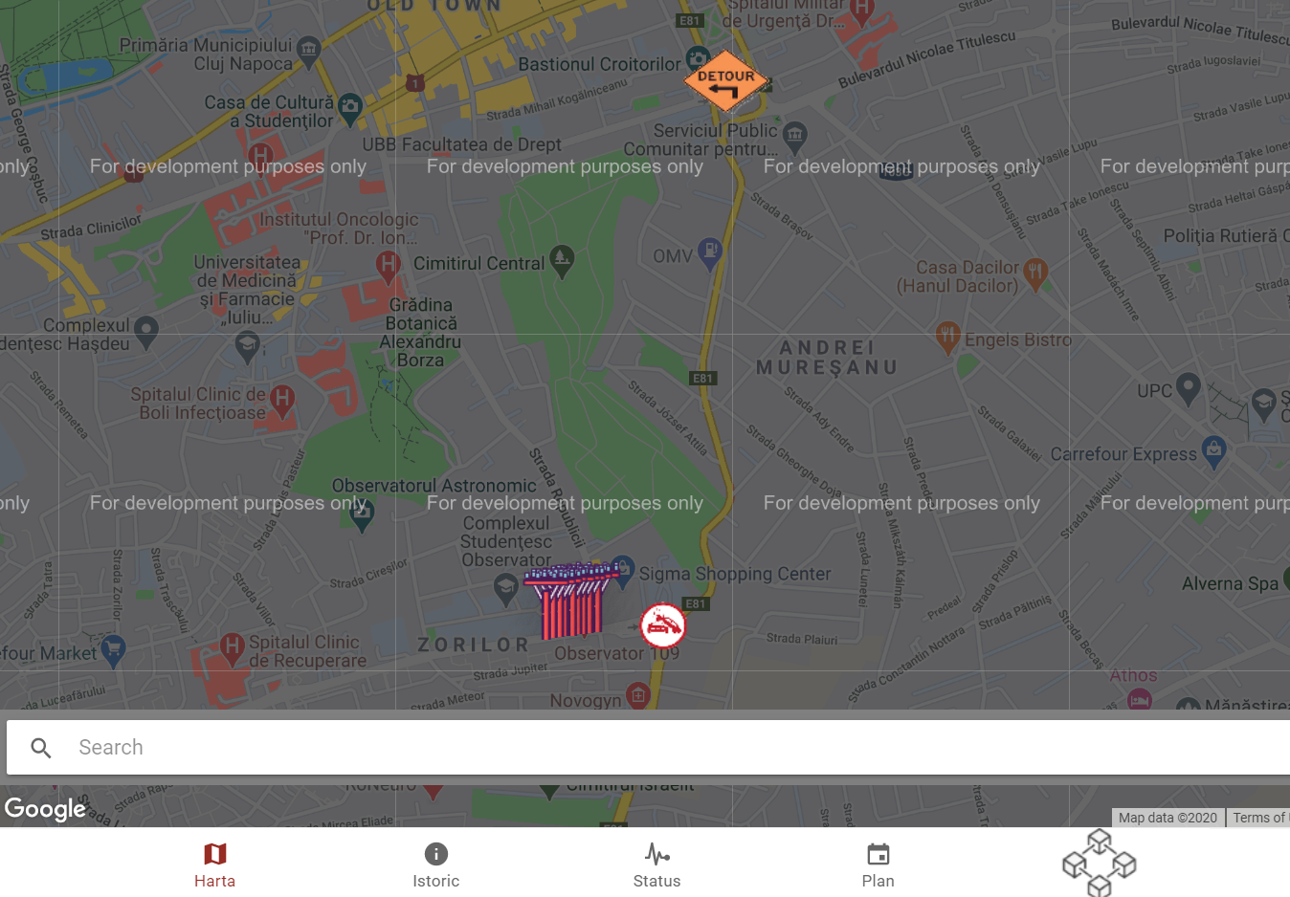

Slide 13
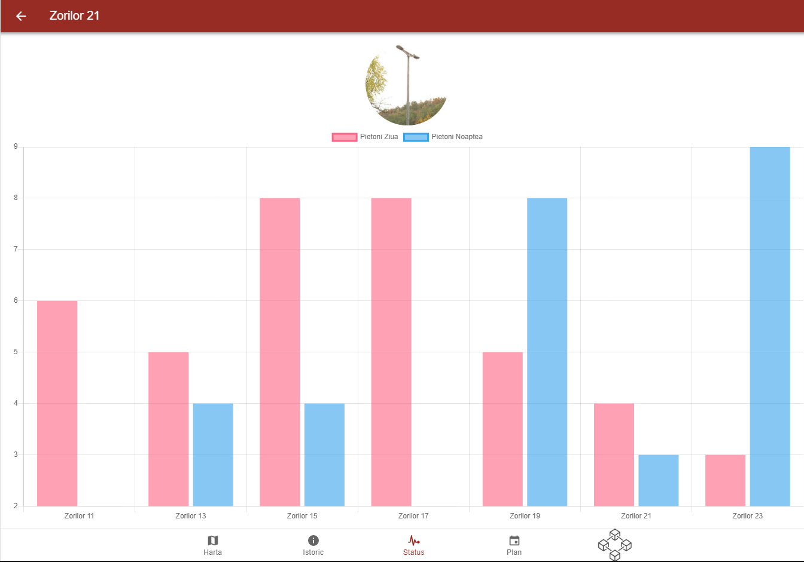
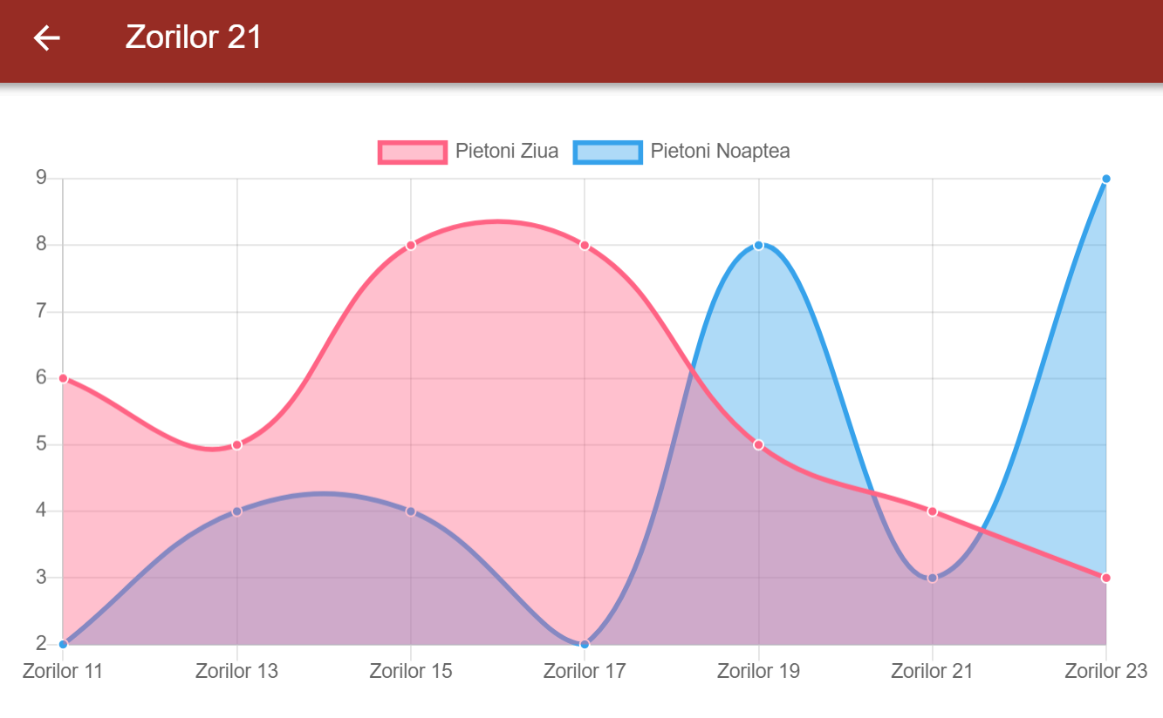

Slide 14
MARKET VALIDATION

Slide 15
LOCAL ADMINISTRATION
3700 deaths/day
20% saved/day
500.000 people saved yearly

Slide 16
QUESTIONS
?

Slide 17
THANK YOU for your attention

